Slide 1
Sampling Plans

Slide 2
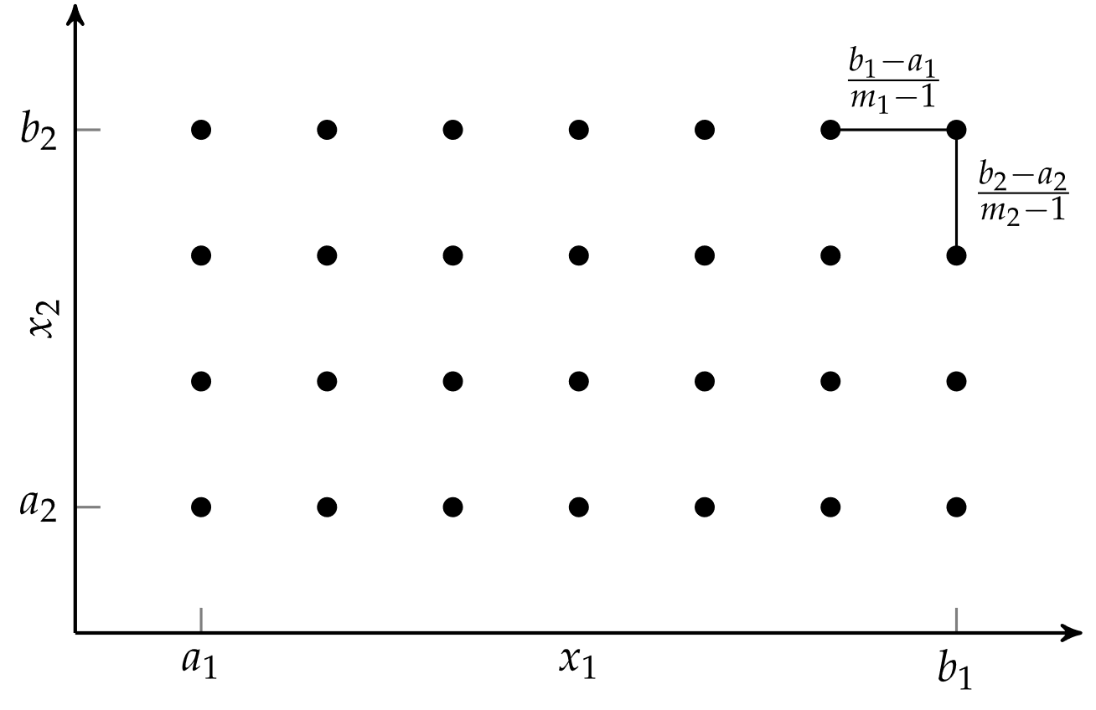
Full Factorial
Uniform and evenly spaced samples across domain
Simple, easy to implement, and covers domain
Sample count grows exponentially with dimension

Slide 3
Random Sampling
Uses pseudorandom number generator to define samples according to our desired distribution
If variable bounds are known, a common choice is a uniform distribution across domain of possible values
Ideally, if enough points are sampled and the right distribution is chosen, the design space will be covered

Slide 4
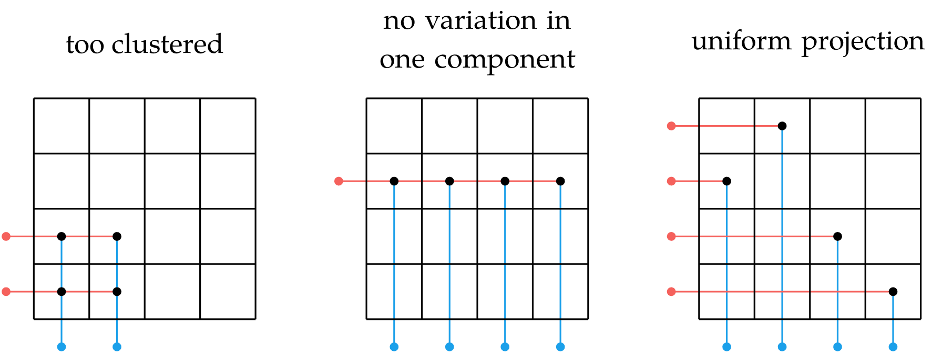
Uniform Projection Plans
Sample locations are random, but their projection onto a particular subspace is uniform

Slide 5
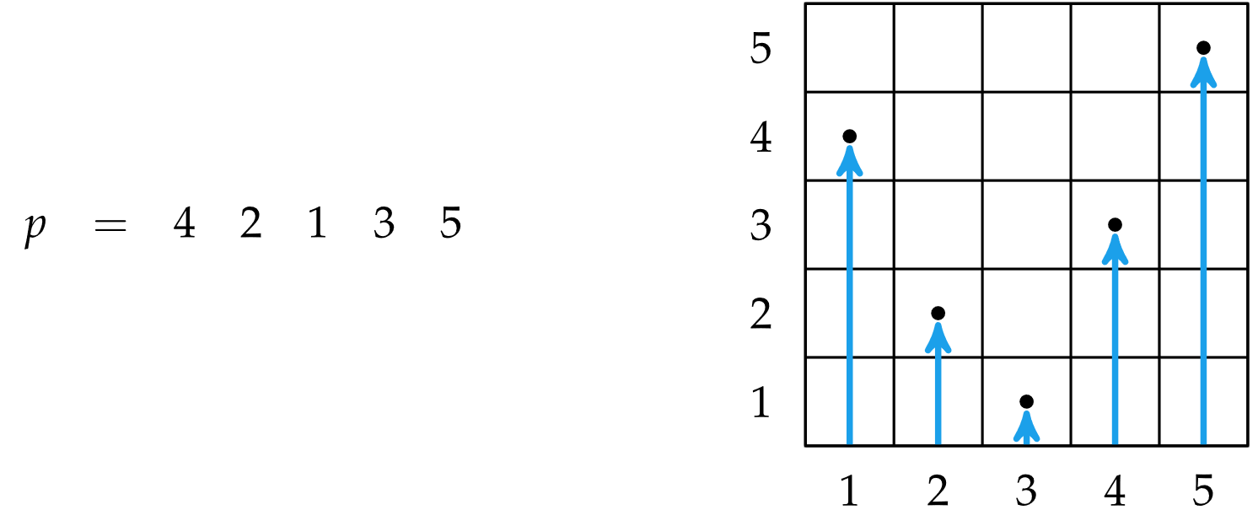
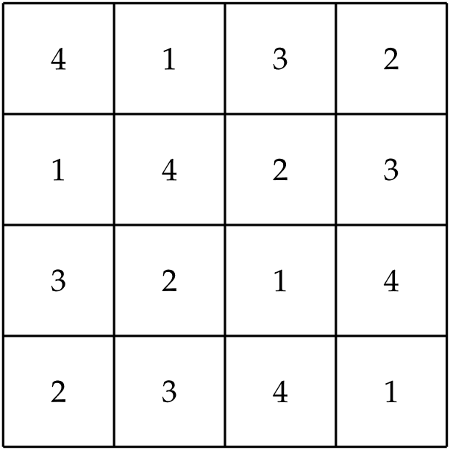
Uniform Projection Plans
Examples: Random permutation, Latin square

Slide 6
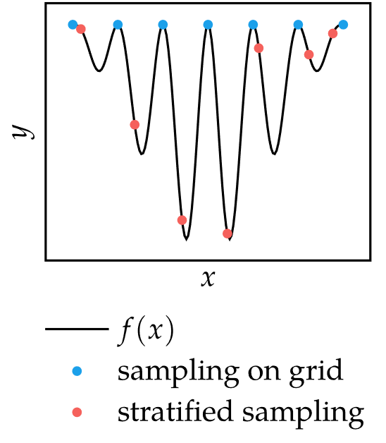
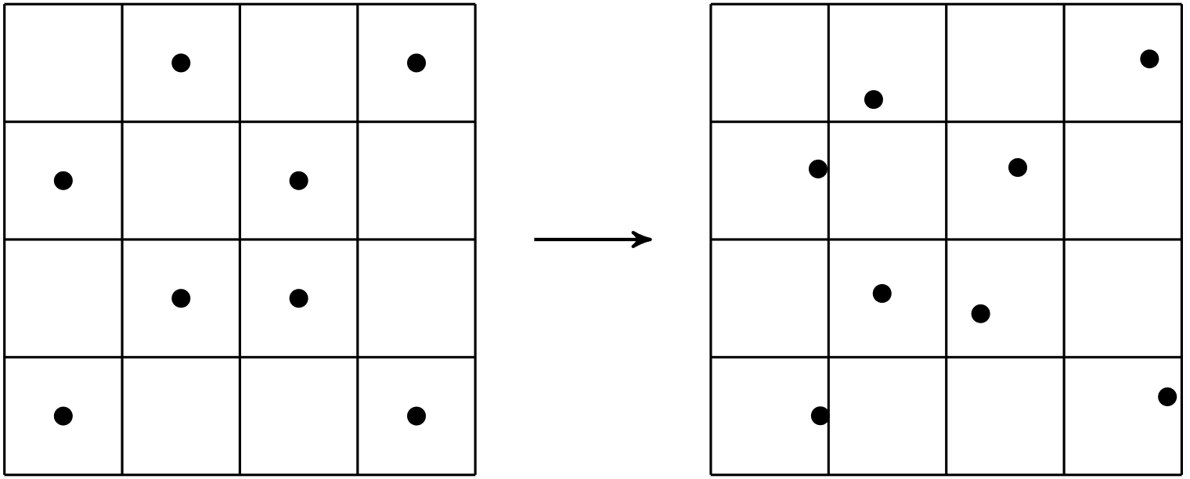
Stratified Sampling
Each point is sampled uniformly at random within each grid cell instead of the center
Can capture details that regularly-spaced samples might miss

Slide 7
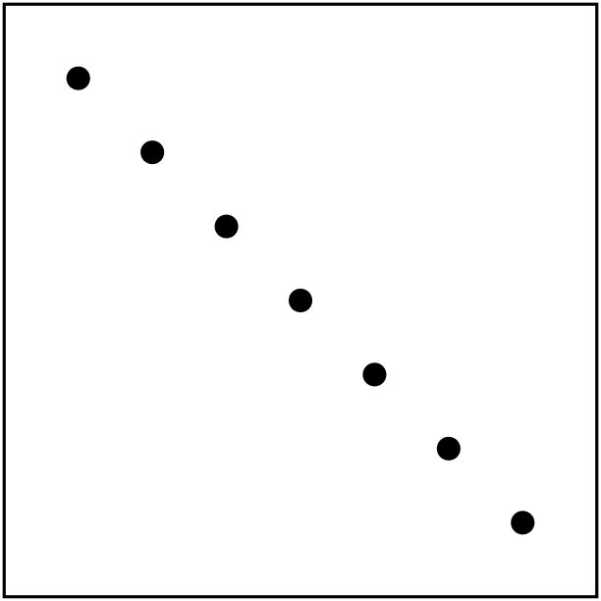
Space-Filling Metrics
A sampling plan may cover a search space fully, but still leave large areas unexplored
Space-filling metrics quantify this aspect of sampling-plan performance
Example: Uniform Projection

Slide 8
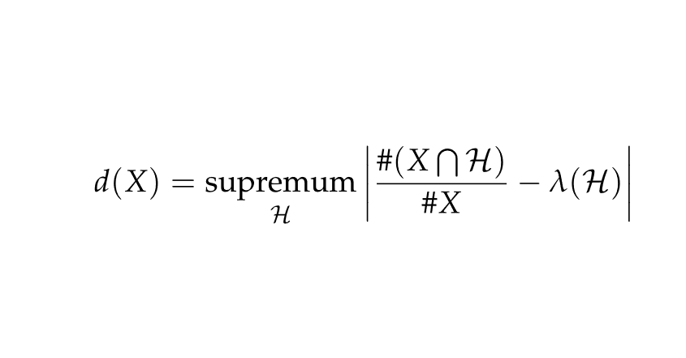
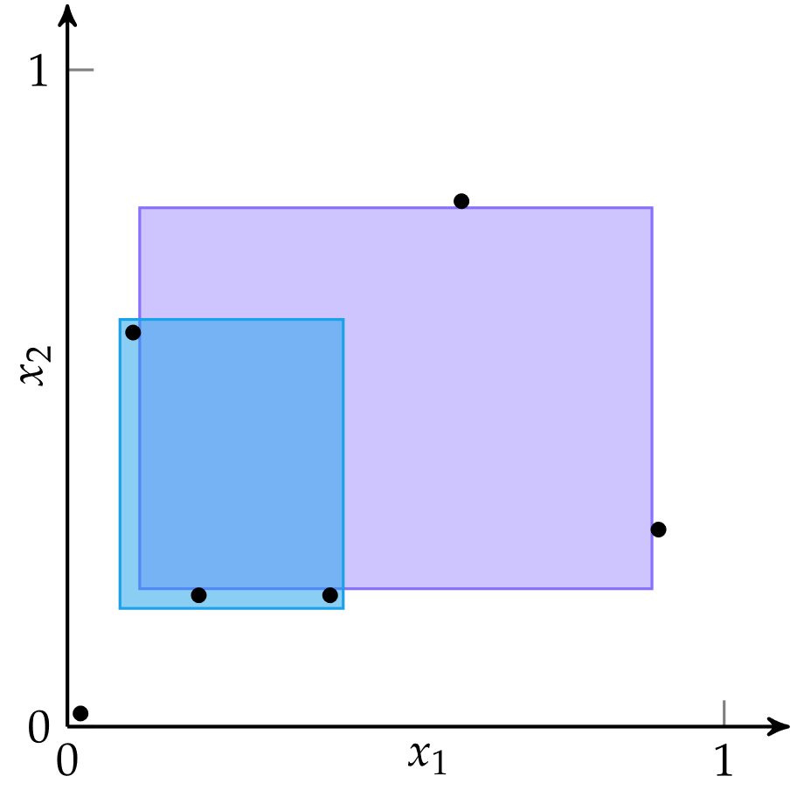
Space-Filling Metrics: Discrepancy
The maximum difference between the fraction of samples in a hyper-rectangular subset H and that subset’s volume
Often very difficult to compute directly

Slide 9
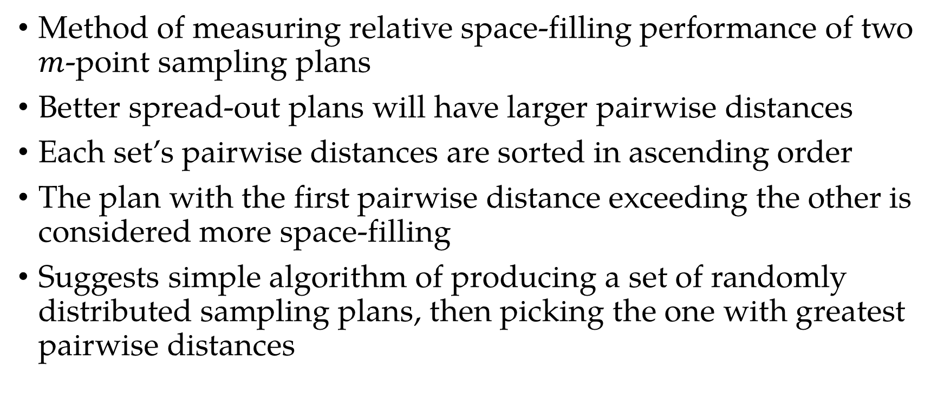
Space-Filling Metrics: Pairwise Distances
Method of measuring relative space-filling performance of two $m$-point sampling plans
Better spread-out plans will have larger pairwise distances
Each set’s pairwise distances are sorted in ascending order
The plan with the first pairwise distance exceeding the other is considered more space-filling
Suggests simple algorithm of producing a set of randomly distributed sampling plans, then picking the one with greatest pairwise distances

Slide 10

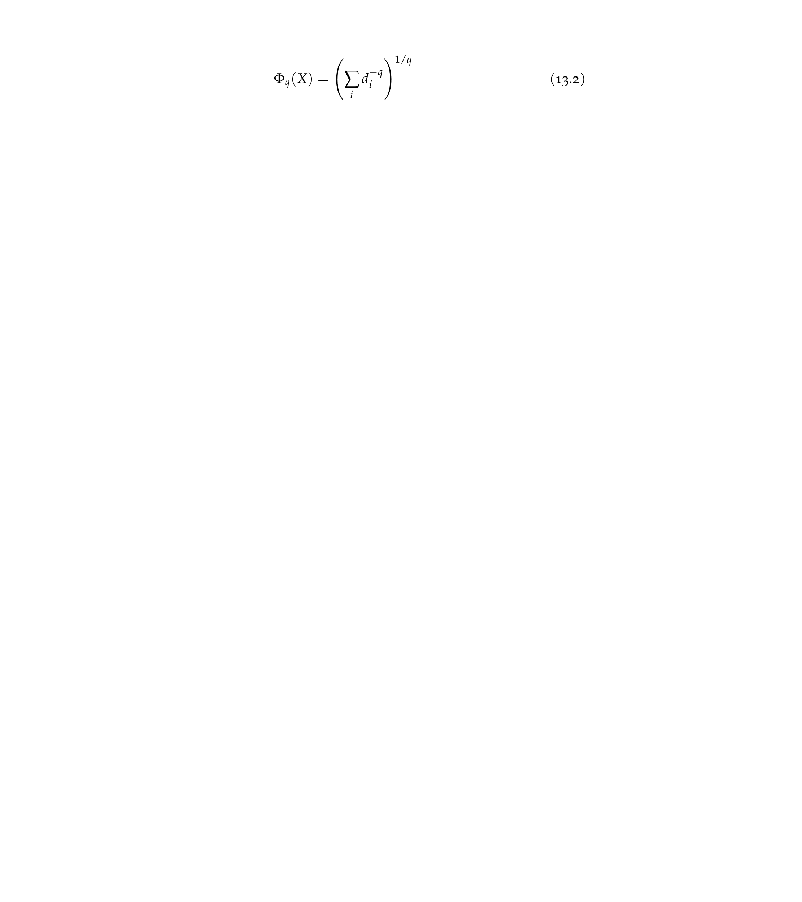
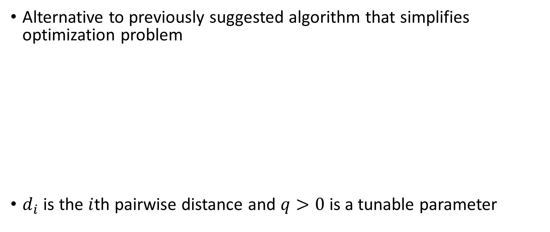
Space-Filling Metrics: Morris-Mitchell
Alternative to previously suggested algorithm that simplifies optimization problem
$d_{i}$ is the $i$th pairwise distance and $q>0$ is a tunable parameter

Slide 11
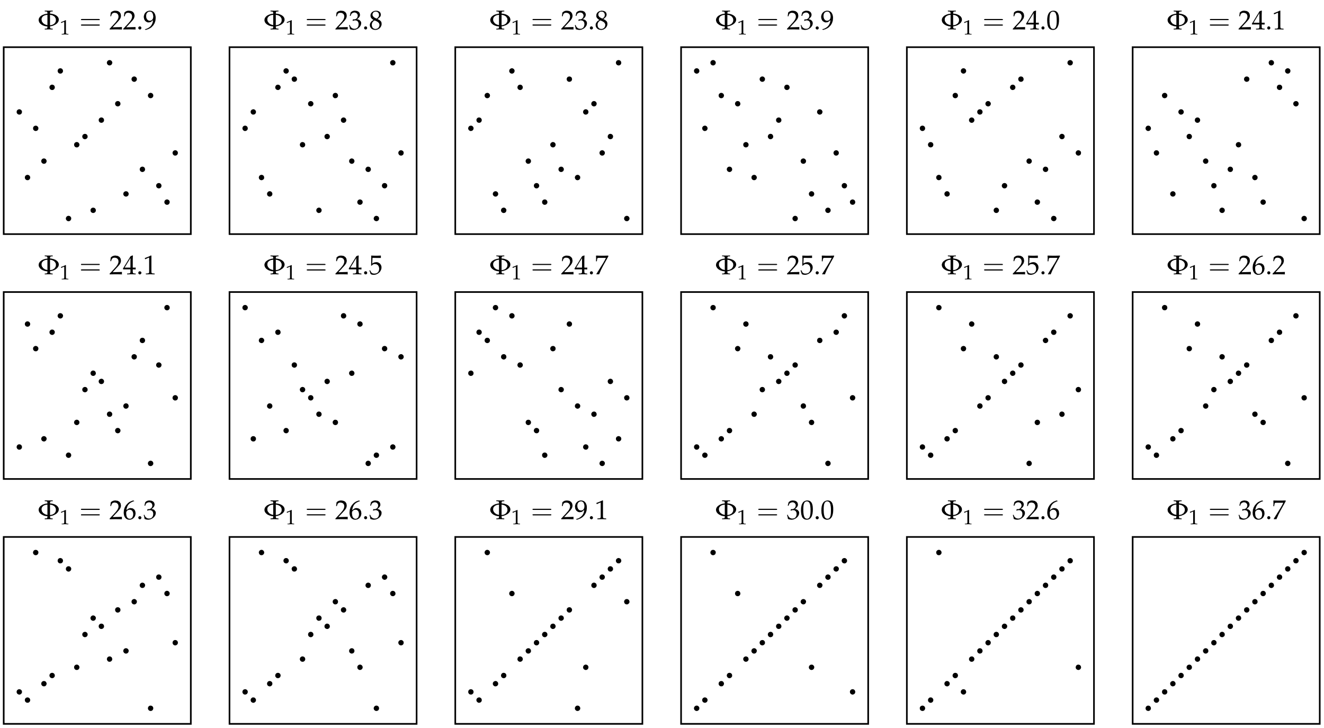
Space-Filling Metrics: Morris-Mitchell

Slide 12
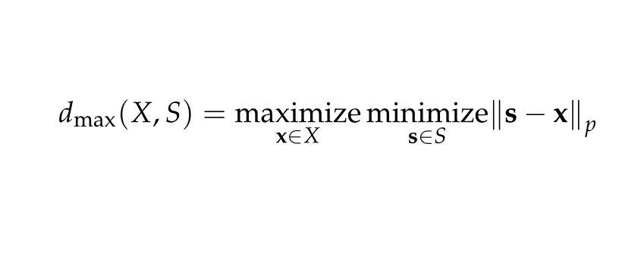
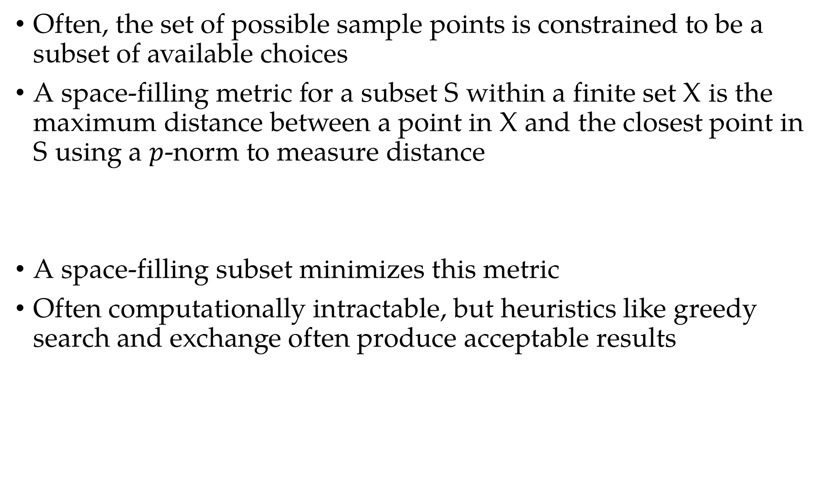
Space-Filling Subsets
Often, the set of possible sample points is constrained to be a subset of available choices
A space-filling metric for a subset S within a finite set X is the maximum distance between a point in X and the closest point in S using a $p$-norm to measure distance
A space-filling subset minimizes this metric
Often computationally intractable, but heuristics like greedy search and exchange often produce acceptable results

Slide 13
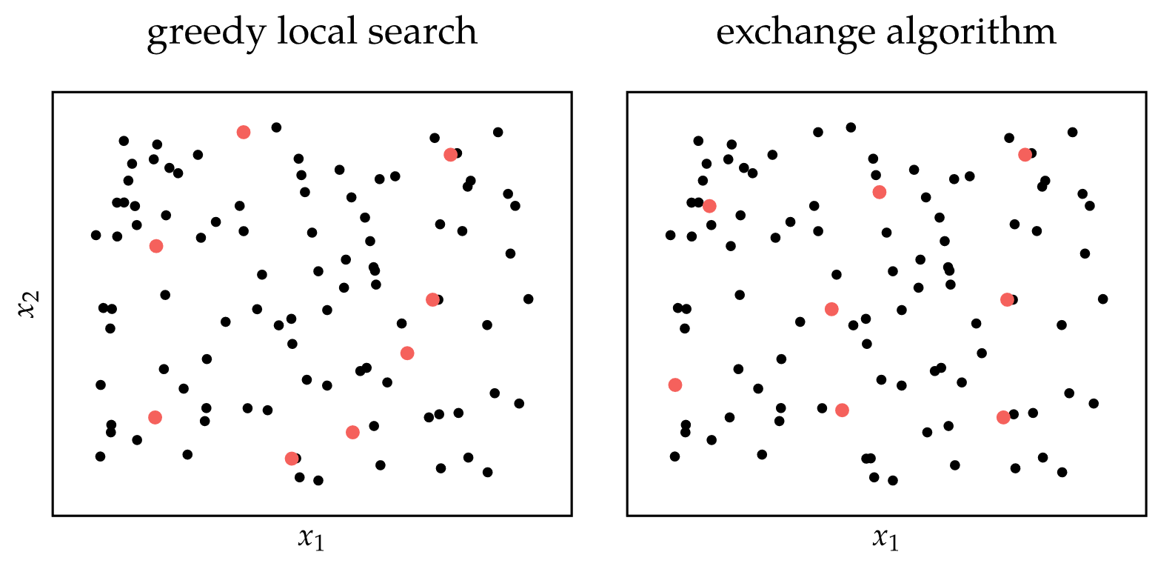
Space-Filling Subsets

Slide 14
Quasi-Random Sequences
Also called low-discrepancy sequences, quasi-random sequences are deterministic sequences that systematically fill a space such that their integral over the space converges as fast as possible
Used for fast convergence in Monte Carlo integration, which approximates an integral by sampling points in a domain

Slide 15
Quasi-Random Sequences
Additive Recurrence: recursively adds irrational numbers
Halton Sequence: sequence of fractions generated with coprime numbers
Sobol Sequence: recursive XOR operation with carefully chosen numbers

Slide 16
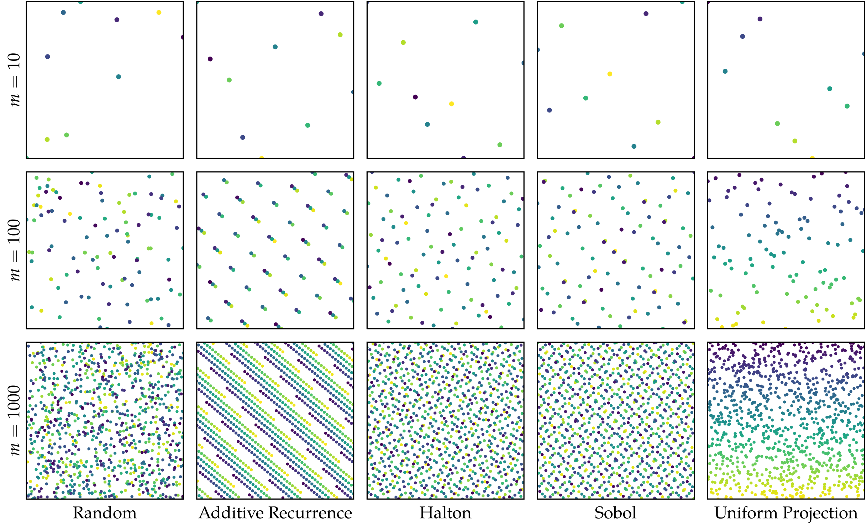
Quasi-Random Sequences

Slide 17
Summary
Sampling plans are used to cover search spaces with a limited number of points
Full factorial sampling, which involves sampling at the vertices of a uniformly discretized grid, requires a number of points exponential in the number of dimensions
Uniform projection plans, which project uniformly over each dimension, can be efficiently generated and can be optimized to be space-filling

Slide 18
Summary
Greedy local search and the exchange algorithm can be used to find a subset of points that maximally fill a space
Quasi-random sequences are deterministic procedures by which space-filling sampling plans can be generated

